Slide 1



Walmart
Sales Analysis

Slide 2

Presentors
Abhay Vaidian
Akshaya Ananthakrishnan
Akshaya Sivakumar
Harish Sathiyanarayanan
Mohammed Zulfiqar Tabassi
Rakshit Mathur
Sriram Vegesana
Vidhi Jain
Group 6

Slide 3

Agenda
01 | Introduction
02 | Data description
03 | Analysis
04 | Statistical Modeling
05 | Results
06 | Conclusion

Slide 4


Research Question
How do Macroeconomic factors affect Walmart’s sales trends and seasonality in the United States?

Slide 5

Introduction
01
02
03
04
Question of Interest
Expected Outcome
Background
Goal
Data range: Year 2010 - 2012
Time period of interest: Year 2010 - 2012
Use Trend Analysis and Regression to understand impact of macroeconomic factors
What macroeconomic factors affect fluctuations in sales?
Key drivers influencing sales patterns
Recommendations for optimizing business operations

Slide 6
Store
Date
Weekly_Sales
The store number
The week of sales
Sales for the given store
Data Description
Holiday_Flag
Temperature
If special holiday week, then 1
else 0 for non-holiday week
Temperature on the day of the sale
Fuel_Price
CPI
Unemployment
Cost of fuel in the region
Prevailing consumer price index
Prevailing unemployment rate

Slide 7




Analysis
Store Sales
Quarterly Growth rates
Forecast weekly sales
Predict weekly sales while interpreting the effect of the holiday season on sales.
Calculating the quarterly growth rates for each store.
Utilize time series analysis to forecast weekly sales.

Slide 8
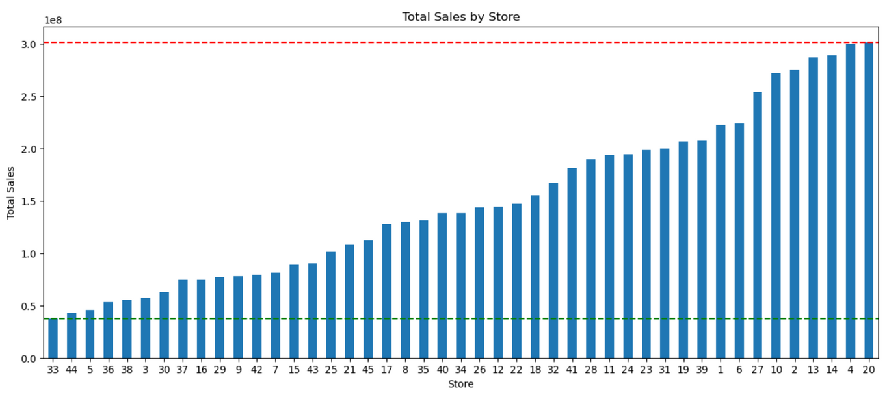
Store Sales
Insights on total sales:
Store with maximum sales: 20
Maximum sales: $301,397,792.46
Store with minimum sales: 33
Minimum sales: $37,160,221.96

Slide 9
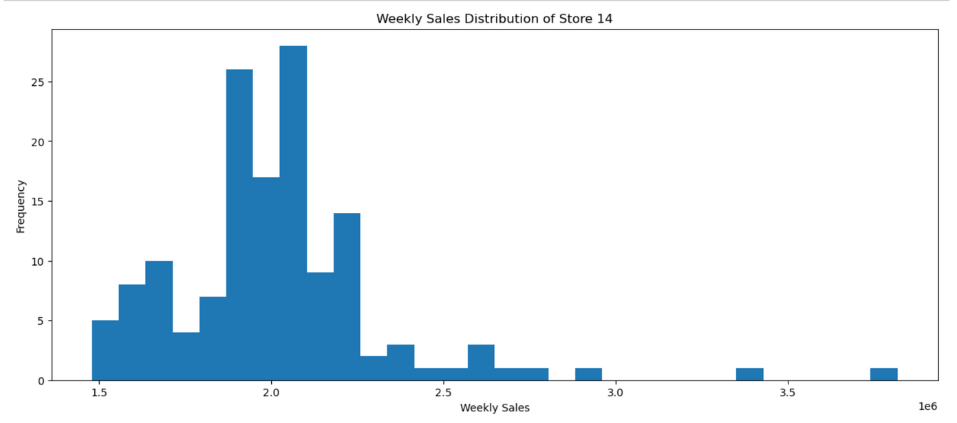
Store standard distribution
In order to better understand store to store behavior, we calculated the standard distribution of sales for each store.
Store 14 has the highest standard deviation in sales with the among being $317,570.
This analysis allows for benchmarking goals to be set for each individual store.

Slide 10
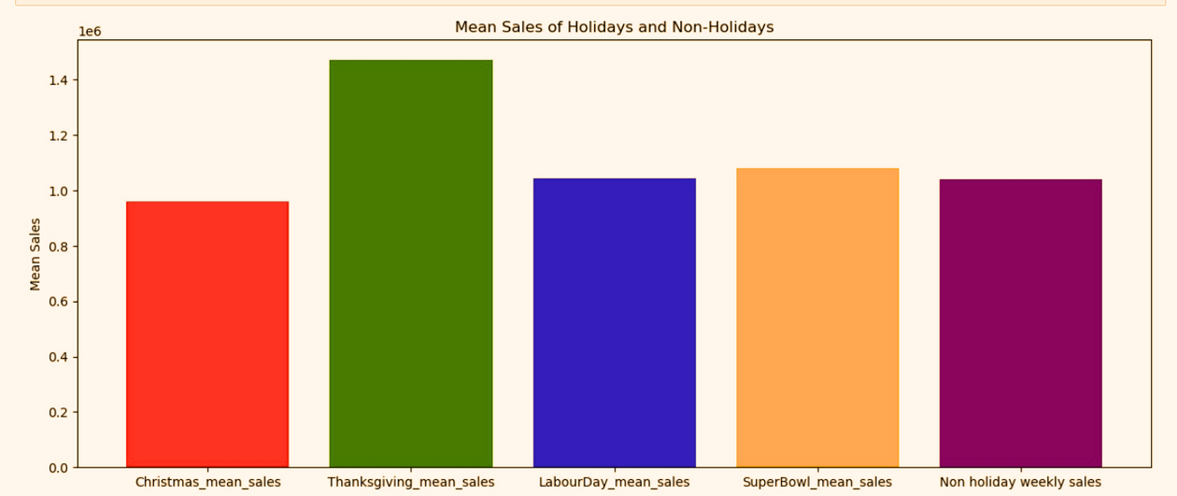
Holiday Season Sales
After analyzing four main holiday seasons, it is evident that the Thanksgiving_mean_sales rank much higher than other holidays and non holiday sales at $1,471,273.

Slide 11
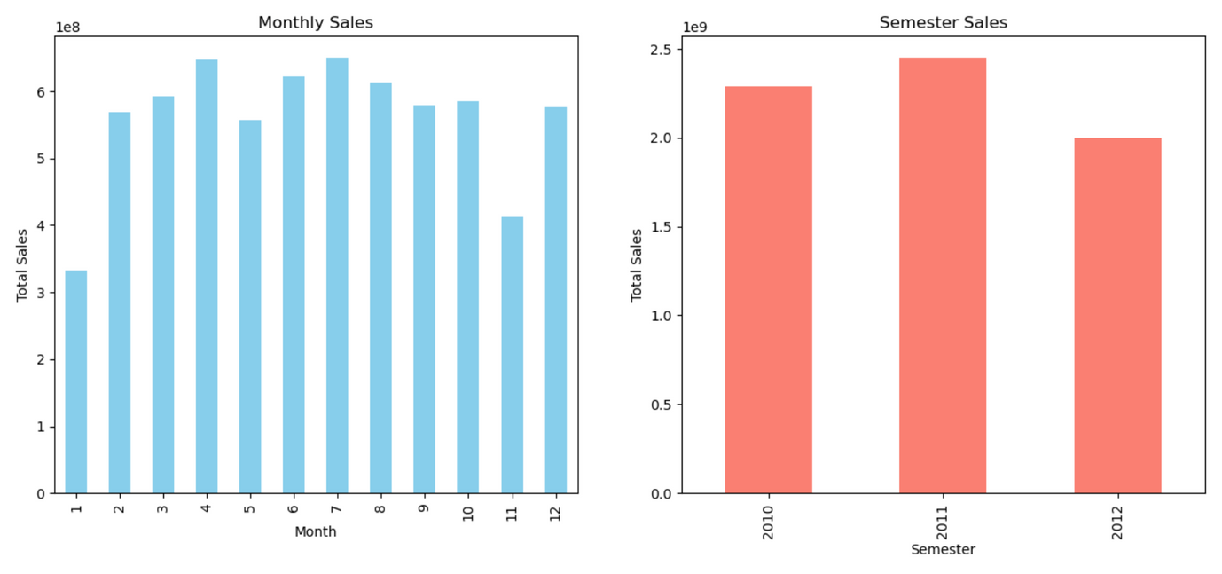
In the first graph, we see the Monthly Sales. These sales appear to fluctuate monthly, with April and July having higher sales than other months.
The second graph, Semester Sales. This graph indicates that sales figures are almost consistent across the three years, with little to no variation observed.

Slide 12
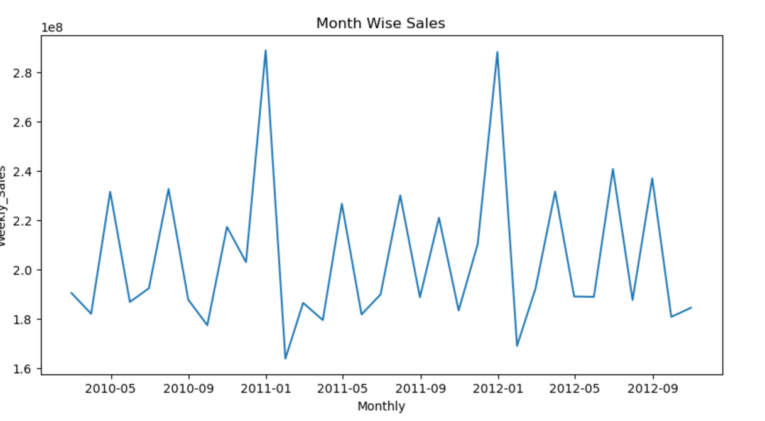
This graph here shows the monthly sales data over a period spanning from May 2010 to September 2012.
The trend exhibits a clear cyclical pattern, with sales peaking around May and September of each year, and dipping during January. This recurring pattern suggests a seasonal trend in sales, where demand is higher during certain months and lower during others.

Slide 13
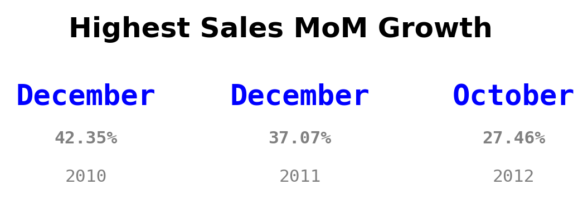
Although Thanksgiving holiday on November has highest sales than the other holiday, December has the highest growth sales happening before Christmas in 2010 and 2011. It stated that in 2012, October become the highest MoM sales growth because we don't have sales data on December 2012.

Slide 14
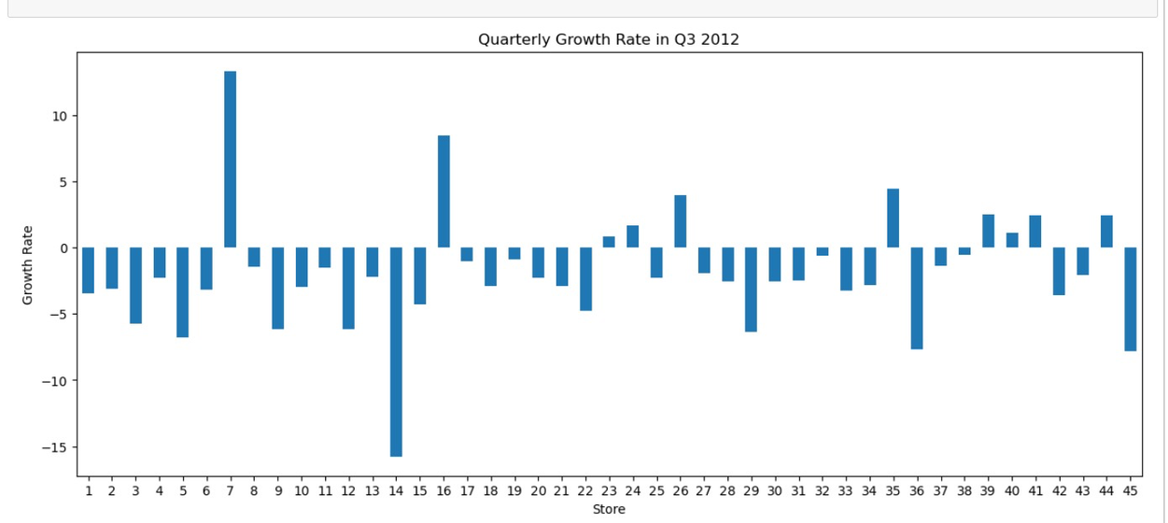
Quarterly Growth Rate
Understanding the quarterly growth rate is crucial for business. It helps compare against competitors and industry standards.
The store with the best quarterly rate in Q3 was store 7, with a growth rate of 13.3307%.

Slide 15
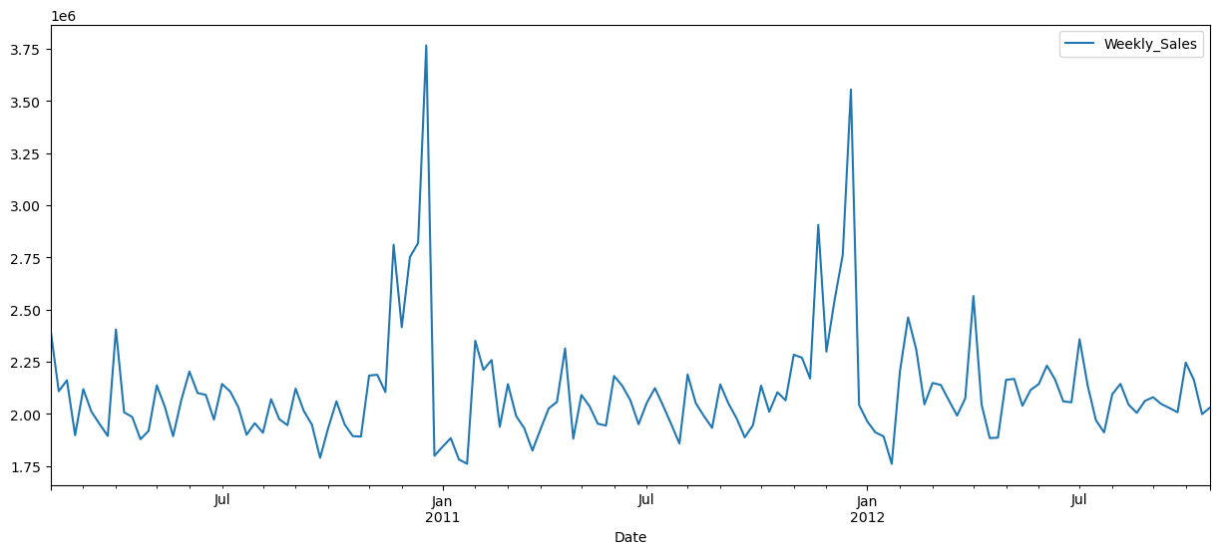
Visualizing the weekly sales of Store 20, the store with the highest sales, reveals clear seasonality patterns. To leverage this insight, we aim to construct an ARIMA model for forecasting Store 20's weekly sales. This model can then be extrapolated to predict sales for other stores as well.

Slide 16
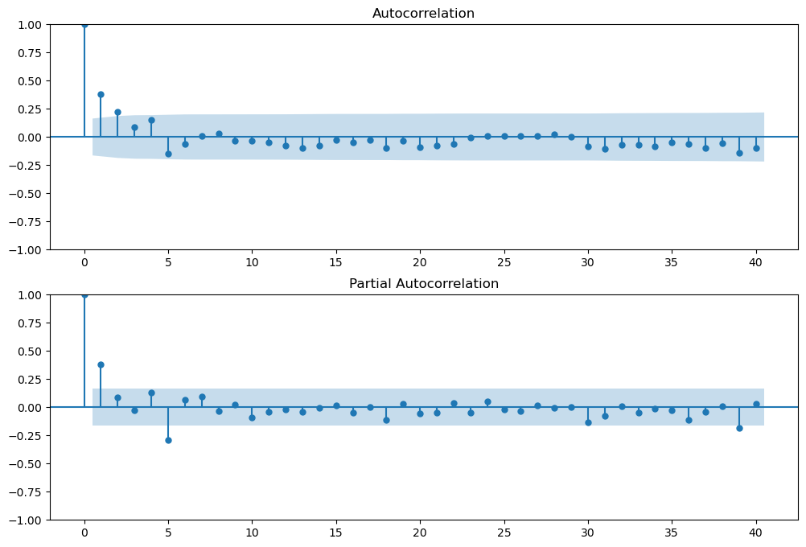
To draw the ARIMA model, we first need to have the Autocorrelation and Partial Autocorrelation model.
From the Autocorrelation and Partial Autocorrelation graphs, we get the p,d,q values.
We can use these p,d, and q values in the ARIMA model for trend analysis.

Slide 17
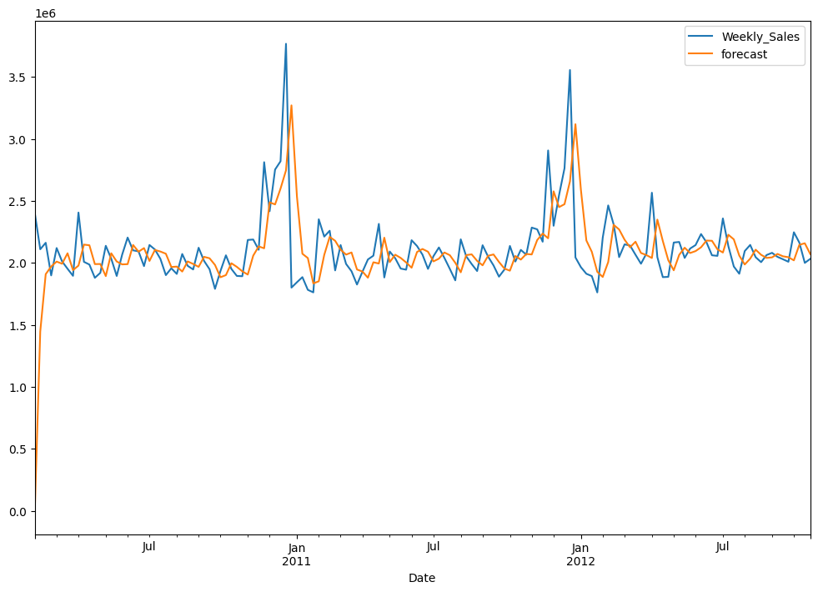
From the visualization, we can see that the forecasted value matches the actual value.
And then calculating the
Mean Absolute Percentage Error we get MAPE is 8.52%
This help us understand that the model is a good fit.

Slide 18
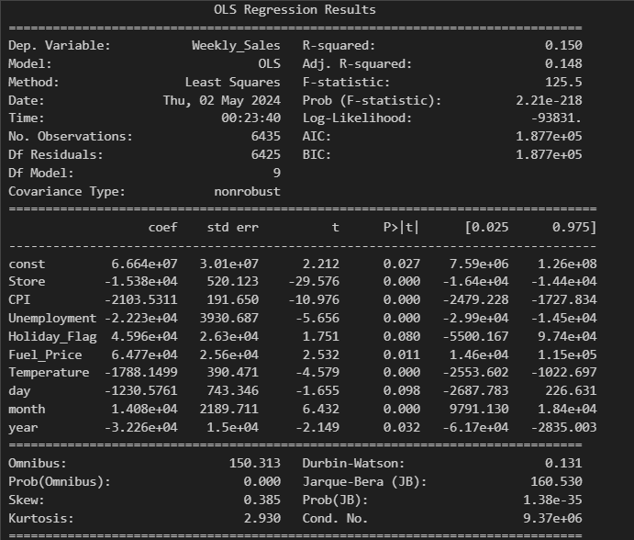
We obtain the following results by drafting a simple OLS model with Weekly Sales as the dependent variable and all the other variables as the independent variable.
These observations show that all the variables except holiday_flag are significant at the 5% level.

Slide 19
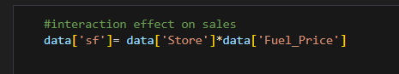
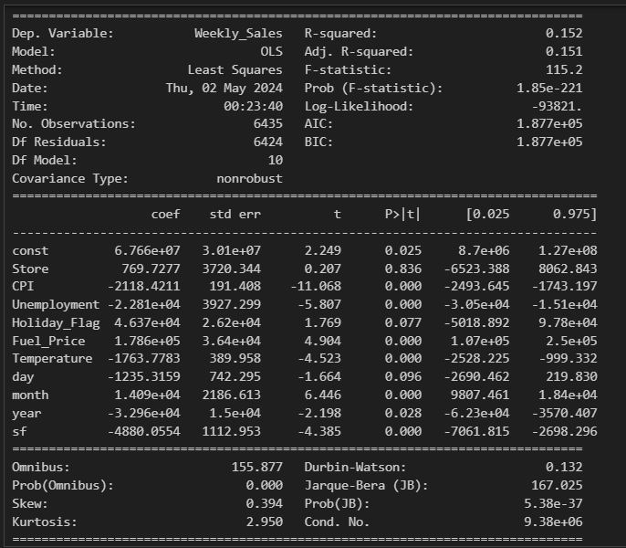
We further expanded our analysis to include an interaction term sf that is the product of Store*Fuel price to see its effect on the model
From the results, we can conclude that the interaction term has a significant effect on the model.
The only downside is that adding the interaction term makes the Store variable insignificant.

Slide 20
From our Analysis so far, we have found that there is a seasonality trend followed in the data, and also, a regular regression model gives good results with all the variables having a significant impact on the model.
Hence, the final step was to devise a pooled OLS model on the Panel data for all the stores.

Slide 21
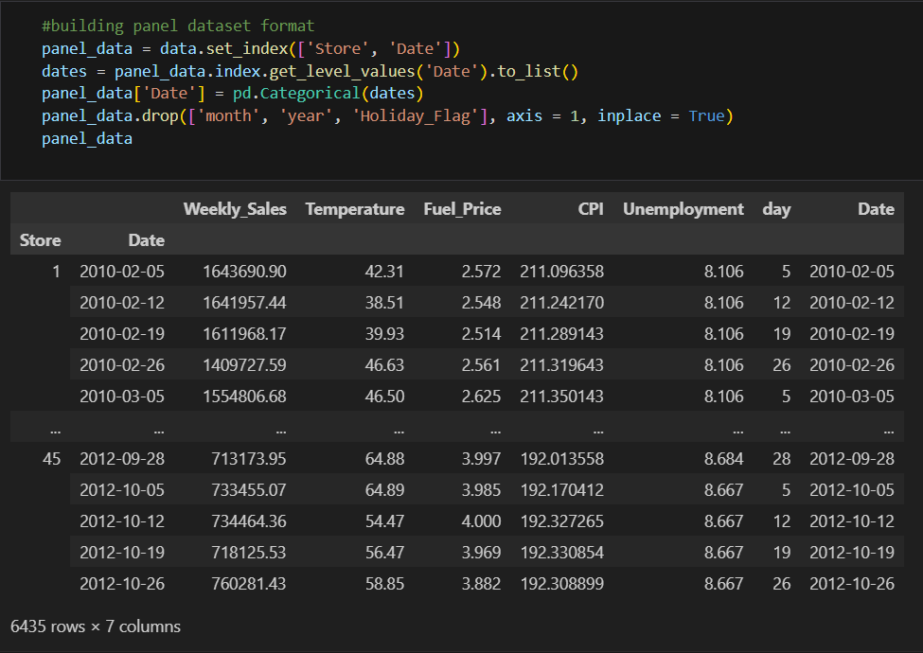
Panel data

Slide 22
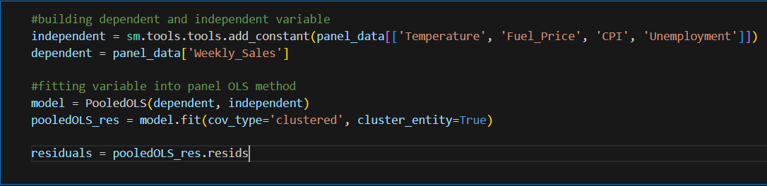
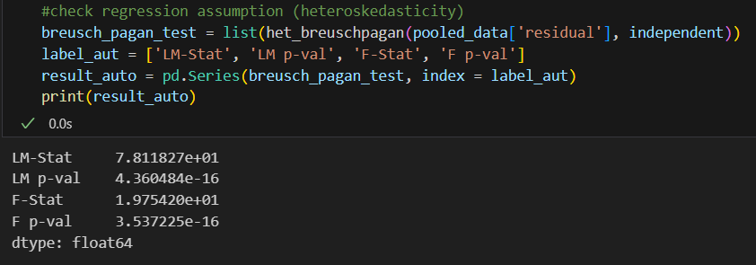
Pooled OLS Model testing
If p value less than alpha (0.05), then there is no heteroskedasticity vice versa. Because p value is 3.53 that more than 0.05, so there is violation in heteroskedasticity

Slide 23
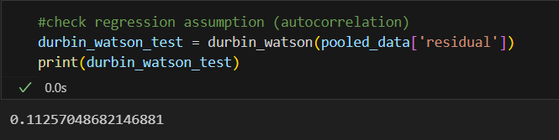
Pooled OLS Model testing
The Durbin-Watson statistic is 0.1126, which is much less than 2. This suggests a strong positive autocorrelation among the residuals. Such a result can invalidate the statistical tests of significance that assume independence of residuals, leading to unreliable coefficient estimates and other inferential statistics.
Well here we will use Fixed Effect and Random Effect method.

Slide 24
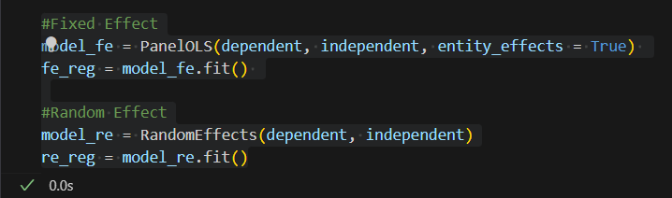
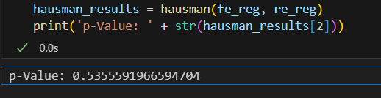
Fixed effect or Random effect (Hausman test)
H0: The preferred model is RE
H1: The preferred model is FE
Given the p-value > 0.05 , it suggests that the random effects model might be suitable since it allows for generalizing inferences beyond the sample used in the study.

Slide 25
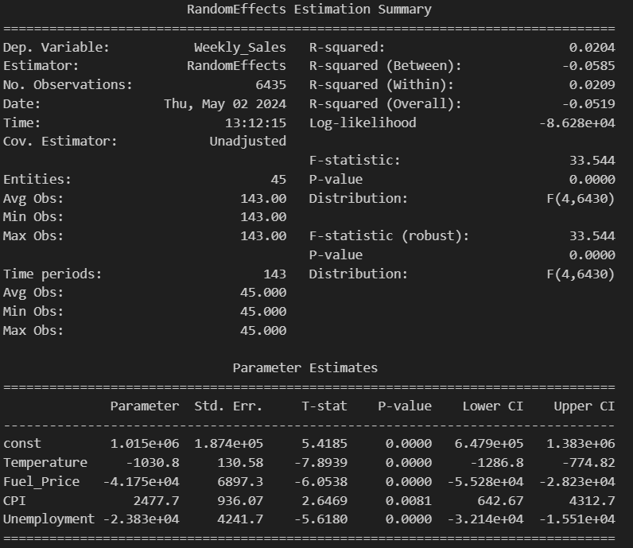
Results Interpretation
We see here that all independent variable (Temperature, CPI, Fuel Price and Unemployemnet) are significant on Weekly Sales. Although these relationship has significant correlation, the slopes are small, so is R2.

Slide 26
Conclusions:
There is seasonal component in sales through holiday date, so the management have to taking into account the seasonal to stocking, merchandising, marketing etc. decision.
Although Thanksgiving Holiday in November contributed more sales than other holiday, it seems that December has higher MoM growth sales happening before Christmas.
Store 20 indeed has a high sales volume for 3 years. However, it's growth has been dominated by holiday date. Forecasting weekly sales of store 20 the results match the actual value.
Simple OLS regression model shows that all the variables have a significant impact on Sales.
Using econometrics (panel regression method), we found that macroeconomic condition have significant relationship with weekly_sales even though it has small slope and R2. It means that there are external factor outside the model greatly affecting Walmart sales. Possibly it can be the customer buying behaviour, social factor, technology and other issue.

Slide 27

Thank you!

